Slide 1
ODE Update
Aaron Rausch, Budget and School Funding
Marjorie Yano, Policy and Legislative Affairs

Slide 2
House Bill 110
Conference Committee unanimously reported on June 28.
Senate approved 32-1.
House approved 84-13.
Governor signed on June 30.
14 vetoes, 4 related to education.
Some provisions effective immediately, others on September 30, 2021 (90 days).

Slide 3
State Budget Bill Funding Provisions

Slide 4
Increased Funding for K-12 Education
Compared to estimated FY21 spending, HB 110 increases state spending on K-12 Education by $534.7 million (5.6%) in FY22 and an additional $203.8 million (2.0%) in FY23.
The final passed budget adds an additional $1.28 billion in new state spending in the 22-23 biennium compared to estimated FY21 spending.
Note: State spending is comprised of GRF, Lottery, and Dedicated Purpose Funds with GRF cash transfers.

Slide 5
School Funding – Key Changes
Implements the Fair School Funding Plan for FY22 and FY23.
Direct funding for Community Schools, STEM Schools, Scholarship Programs, and Open Enrollment (fund students where they are educated).
Establishes a base cost methodology based on student teacher ratios, minimum staffing levels, and actual costs.
Implements a new state and local cost methodology using property and income for all districts.
Revises categorical aid and restricts funds for subgroups.

Slide 6
Base Cost
Current Law
Since the 2013-14 school year, this element of the formula is referred to the opportunity grant or formula amount.
In FY19, the per-pupil amount was $6,020.
Calculated based on the current year resident district ADM (formula ADM).
The per-pupil amount has received criticism because it is not connected to the actual cost of educating a student.
As Passed in HB 110
Using an input-based and professional judgement approach to a base cost.
Each school district will generate a different base cost amount.
The Legislative Service Commission (LSC) estimates that, as included in HB 110, the average base cost per pupil will be $7,202 (if fully phased-in).
Calculated using the higher of prior year enrolled ADM or a trailing three-year average, whichever is higher.

Slide 7
Base Cost
The practitioner developed base cost model uses actual district costs (teacher salaries, average expenditures across districts), establishes minimum service levels, and student-teacher ratios to calculate a unique base cost for each district. Base cost funding includes five areas:
Teacher Base Cost
Student Support (including a restricted Student Wellness and Success component)
District Leadership & Accountability
Building Leadership & Operations
Athletic Co-Curricular (contingent on participation)

Slide 8
State/Local Share
Current Law
State share index serves as a measure of a school’s wealth and capacity and serves as the state contribution to the calculation of various funding components.
A range of 5% for the wealthiest districts in the state and 90% for the districts with the lowest capacity.
Calculated based on a relative comparison of three-year average property values for all districts adjusted by income for some districts.
As Passed in HB 110
Replaces the state share index with a variable charge-off amount and a derived state share percentage.
A range of 5% for the wealthiest districts in the state and no maximum.
Uses property values (60%) and two measures of income (40%) for all districts to determine state share percentage.
Updates the state share for each year of the biennium.
Reduces the comparative nature of the state share index.

Slide 9
Targeted Assistance/Capacity Aid
Current Law
Provides scaled targeted assistance funding to schools based on a wealth per pupil measure using average property and income (weighted equally).
Supplemental targeted assistance is more than 10% of real property value is from agriculture values.
Capacity aid funding for schools who generate local revenue for 1 mill of voted property tax that is less than the statewide average.
As Passed in HB 110
Combines the concept of capacity aid and targeted assistance.
Provides additional funding based on a wealth measure using property (weighted at 60%) and income (weighted at 40%).
Provides supplemental targeted assistance to lower wealth districts whose enrolled ADM is less than 88% of its total ADM for FY19.

Slide 10
Categorical Aid
Current Law
Provides additional funding for:
K-3 Literacy
Economically disadvantaged students (restricted funding)
Gifted students
English learners (3 categories)
Students with disabilities (6 categories – restricted funding)
Career-Technical Education (5 categories – restricted funding)
As Passed in HB 110
Provides additional funding beyond base cost for:
Economically disadvantaged students (increased per pupil amount and renamed disadvantaged pupil impact aid)
Gifted students - restricted and adopt 2018 cost study
English learners – restricted, expanded and convert to weights
Students with disabilities – increased per pupil amounts and convert to weights
Career-Technical Education – convert to weights

Slide 11
Student Wellness and Success Funding
Current Law
Student Wellness and Success Funding is a stand-alone item designed to serve all students.
May be used for certain designated initiatives, based on a plan developed with two community partners.
The Governor proposed $1.1 billion for Student Wellness and Success Funding over the next biennium.
Per-pupil funding scaled based on census poverty data.
As Passed in HB 110
Moves Student Wellness and Success Funding initiative into the DPIA funding.
Allows funds to be spent on certain initiatives, including those previously designated under the Student Wellness and Success Funding.
Requires that districts develop implementations plans with a community partner as to how they plan to use these DIPA funds. This is like the requirement that existed under the stand-alone Student Wellness and Success.
Unspent funds from FY20 and FY21 continue to be restricted for SWSF purposes.

Slide 12
Transportation
Current Law
Provides funding based on the greater of:
Statewide average cost per mile
Statewide average cost per rider
Funds all resident district students transported more than 1 mile (traditional, community school, STEM school, and nonpublic student).
Provides supplemental transportation for low-density districts.
Establishes a 25% minimum state share.
As Passed in HB 110
Maintains funding based on the greater of the cost per rider or mile.
Funds all resident students who ride the bus (preschoolers and students who live within 1 mile of school).
Provides additional funding for districts transporting community school, STEM, and nonpublic students.
Targets supplemental transportation funding to low density districts.
Provides additional funding for transportation efficiency.
Increases the minimum state share to 29.17% in FY22 and 33.33% in FY23.

Slide 13
Funding for Scholarship Programs
Current Law
Funding for traditional EdChoice, Autism and Jon Peterson Special Needs scholarships are funded through a deduction from the student’s resident school district.
The Cleveland Scholarship Program is funded both through a deduction from the Cleveland Municipal School District and direct state payments.
As Passed in HB 110
Implements direct funding for traditional EdChoice Scholarship Program, Autism Scholarship Program, and Jon Peterson Special Needs Scholarship Program.
Implements direct funding for Cleveland Scholarship Program.
Increases the maximum scholarship amount for all programs.

Slide 14
Eliminated Funding Components
K-3 Literacy
3rd Grade Reading Proficiency Bonus
High School Graduation Bonus
Capacity Aid (merged with Targeted Assistance)

Slide 15
Funding for Other Education Models
Community Schools, STEM schools, joint vocational school districts, and educational service centers (ESCs) all have new funding methodologies.
Substantially similar to the methodology used for traditional school districts, with some differences to account for the differences in the model.

Slide 16
Phase-In Approach
While House Bill 110 does not include a cap – the full amount calculated by the formula is not paid out to schools and districts. This is executed through a phase-in.
Most components subject to, “general phase-in percentage” of 16.67% in FY22 and 33.33% in FY23.
DPIA phased-in at 0% for FY22 and 14% for FY23.
Transportation funding not subject to phase-in.
Community Schools and STEM schools subject to phase in (new).

Slide 17
Formula Transitional Aid
Often referred to as the “guarantee,” the final version of HB 110 includes a number of guarantees in both temporary law and permanent law to ensure no school receives less than FY21.
For districts, this is an aggerate calculation of state foundation funding – (with funding cuts restored), net of transfers and deductions, plus Student Wellness and Success Funds and other additional aid items.
For community schools and STEM schools, this is calculated in a similar way but on a per pupil basis (new).

Slide 18
School Funding Related Changes
Provides additional funding for:
Preschool special education (eliminate proration)
Special education transportation (simplifies calculation, increases minimum state share, and eliminates proration)
Catastrophic Cost Reimbursement (withholds a portion of special education funding)
Establishes new funding for:
Transportation collaboration grants
Career awareness and exploration funds

Slide 19
School Funding Related Changes
Includes funding for school bus purchase ($50 million).
Provides executive recommended amounts for Quality Community School Support ($54 million)
Increases Community School Facilities Funding from $250 to $500 per pupil ($42.0 million)
Restored Industry Recognized Credential funding ($20.5 million annually)
Increased funding for non-public school via Auxiliary Services and Nonpublic Administrative Cost Reimbursement and allowance for direct funding.

Slide 20
Implementation of HB110
Initial changes in July/August payments.
Net out Scholarship, STEM, and Community School Payments.
Update appropriation limits.
Full implementation by October.
Revised payment reports.
Move to updated calculations.
Future changes to related school finance programs, five-year forecast impact, maintenance of effort impact.

Slide 21
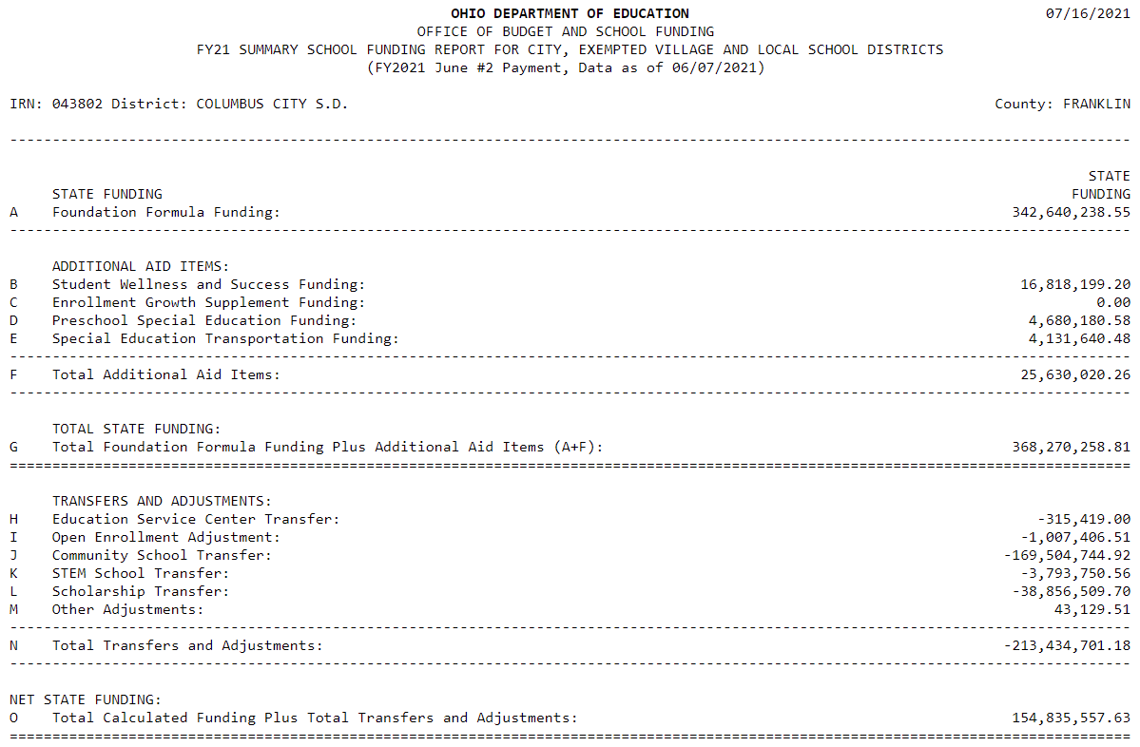
Impact of Direct Funding (Before)

Slide 22
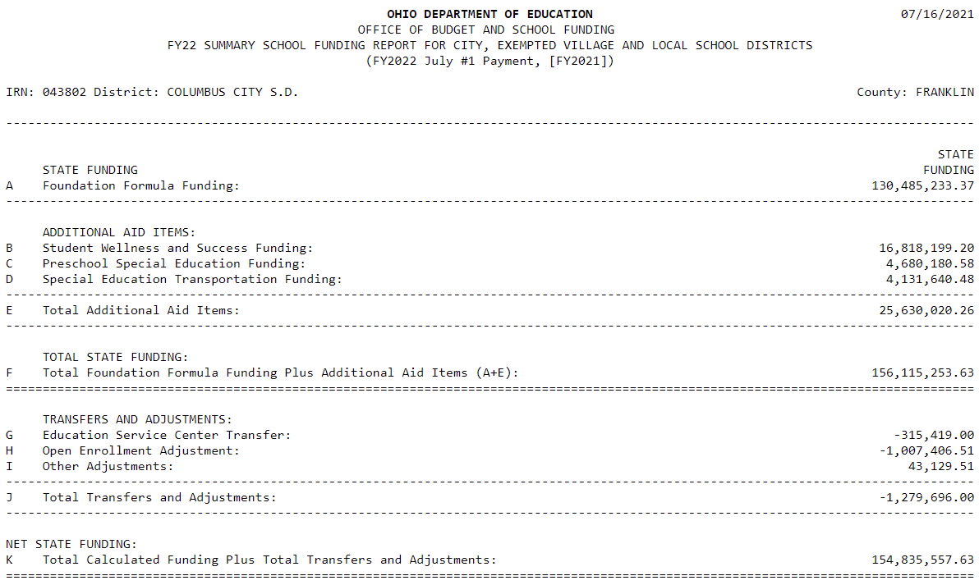
Impact of Direct Funding (After)

Slide 23
What factors influence district aid?
Student Population and Demographics
Property Valuation
Personal Income of District Residents
Historical Funding – Caps and Guarantees
Notes:
Student Population and Demographics: Ohio’s student-centered funding formula provides resources based on a school district’s Average Daily Membership (ADM). Changes in ADM, whether increases or decreases, can have an impact on a school district’s foundation funding. Similarly, changes in the numbers of students and their needs, from special education to those who are economically disadvantaged, also impact the amount of funding each district receives.
Property Valuation: Changes in property valuation, whether increases or decreases in total or in relationship to the statewide average, can have a significant impact on a school district’s foundation funding.
Income: Changes in income, whether increases or decreases, also have an impact on a school district’s foundation funding. The governor’s budget makes an appropriate change in how income is used to more accurately measure capacity that will drive resources to districts with less capacity to generate local revenue and is a significant improvement over the income adjustment in current law.
Historical funding and previous funding levels: The interaction of formula changes, changing characteristics of a district, and the effects of caps/guarantees can cause unexpected results. When “caps” and “guarantees” are used, the outcomes of any formula are suppressed. Because guarantees have been in place without interruption for many years, the guarantee is not necessarily to last year’s amount, but perhaps to a formula calculation from a number of years prior. This means that guaranteed/capped funding amounts are often based upon district factors, such as student population and/or property values, that are dramatically different from what currently exist. Therefore, funding levels for a district relative to a prior year might be due to the impact of lessening those constraints that short-circuit formulas.

Slide 24
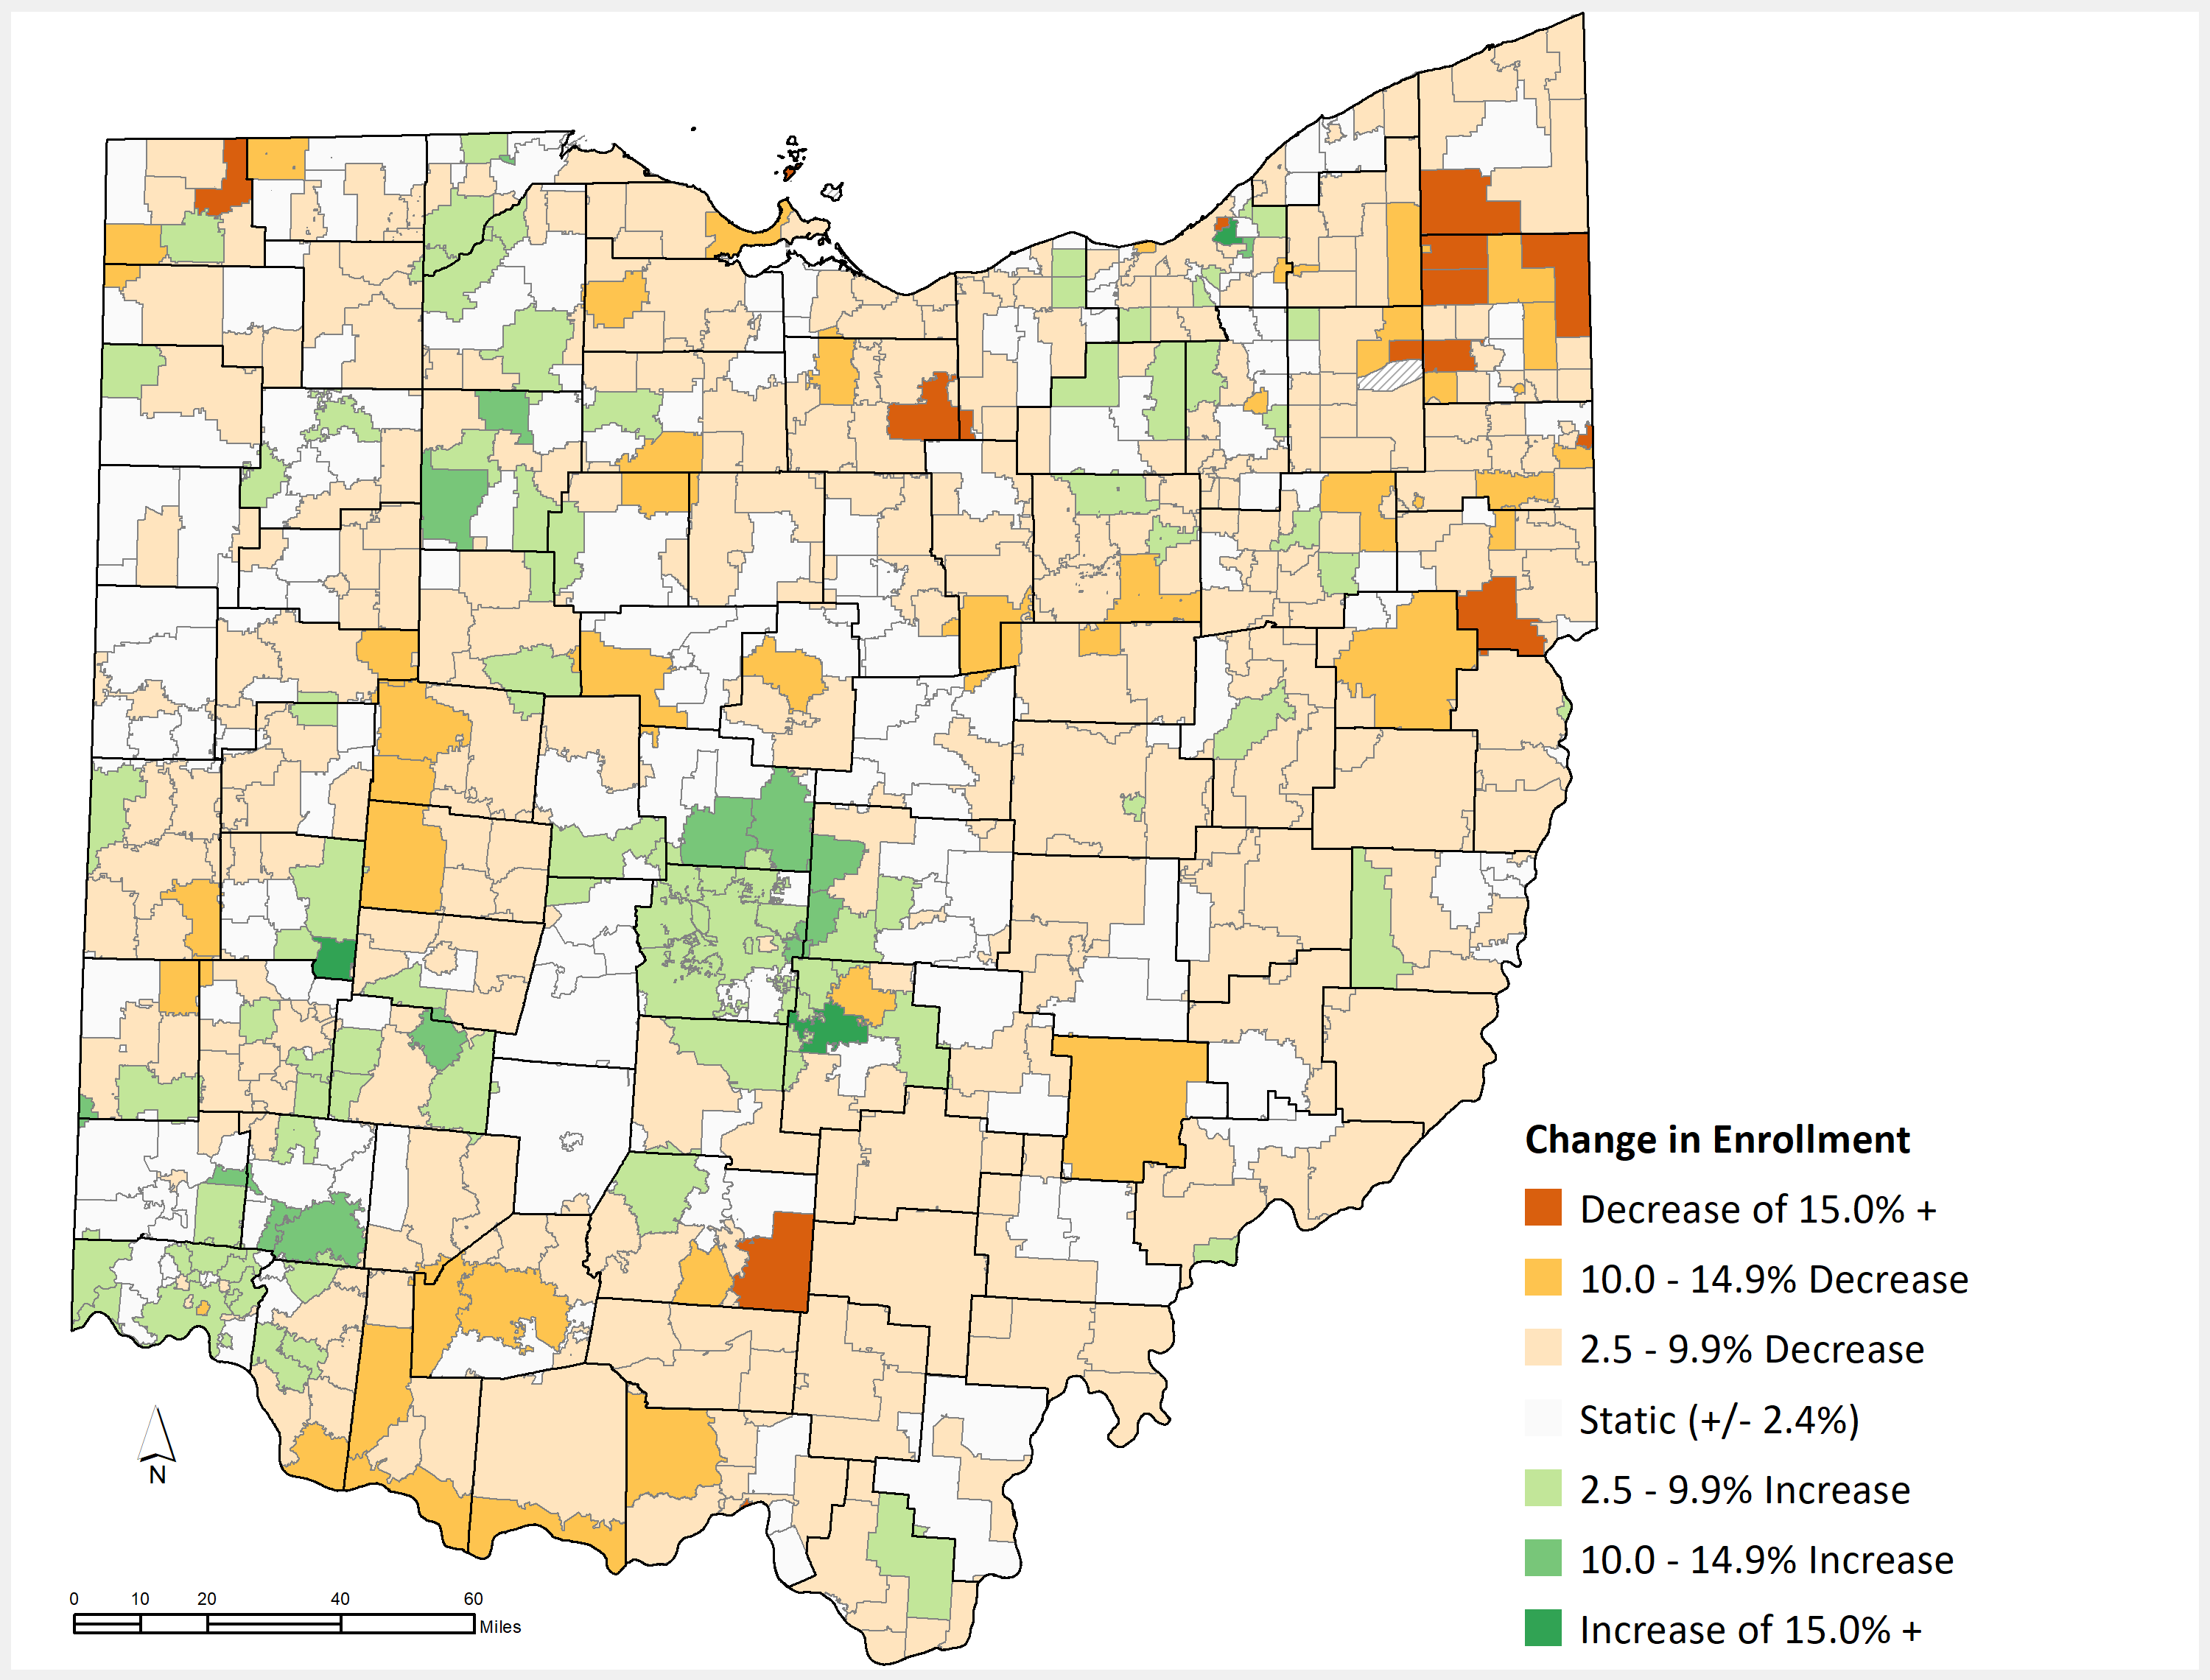
Change in Total ADM in public sector, FY16-20
Notes:
Student Enrollment/Demographics – The number of students who live in a district drive the type of funding a district receives and the state share index (valuation per pupil). Changes in enrollment (increases/decreases) impact the relative change in funding compared to a previous year.
Districts with increasing student enrollment are more likely to see increases in calculated state aid. Districts with decreasing student enrollment are more likely to see decreases in calculated state aid.

Slide 25
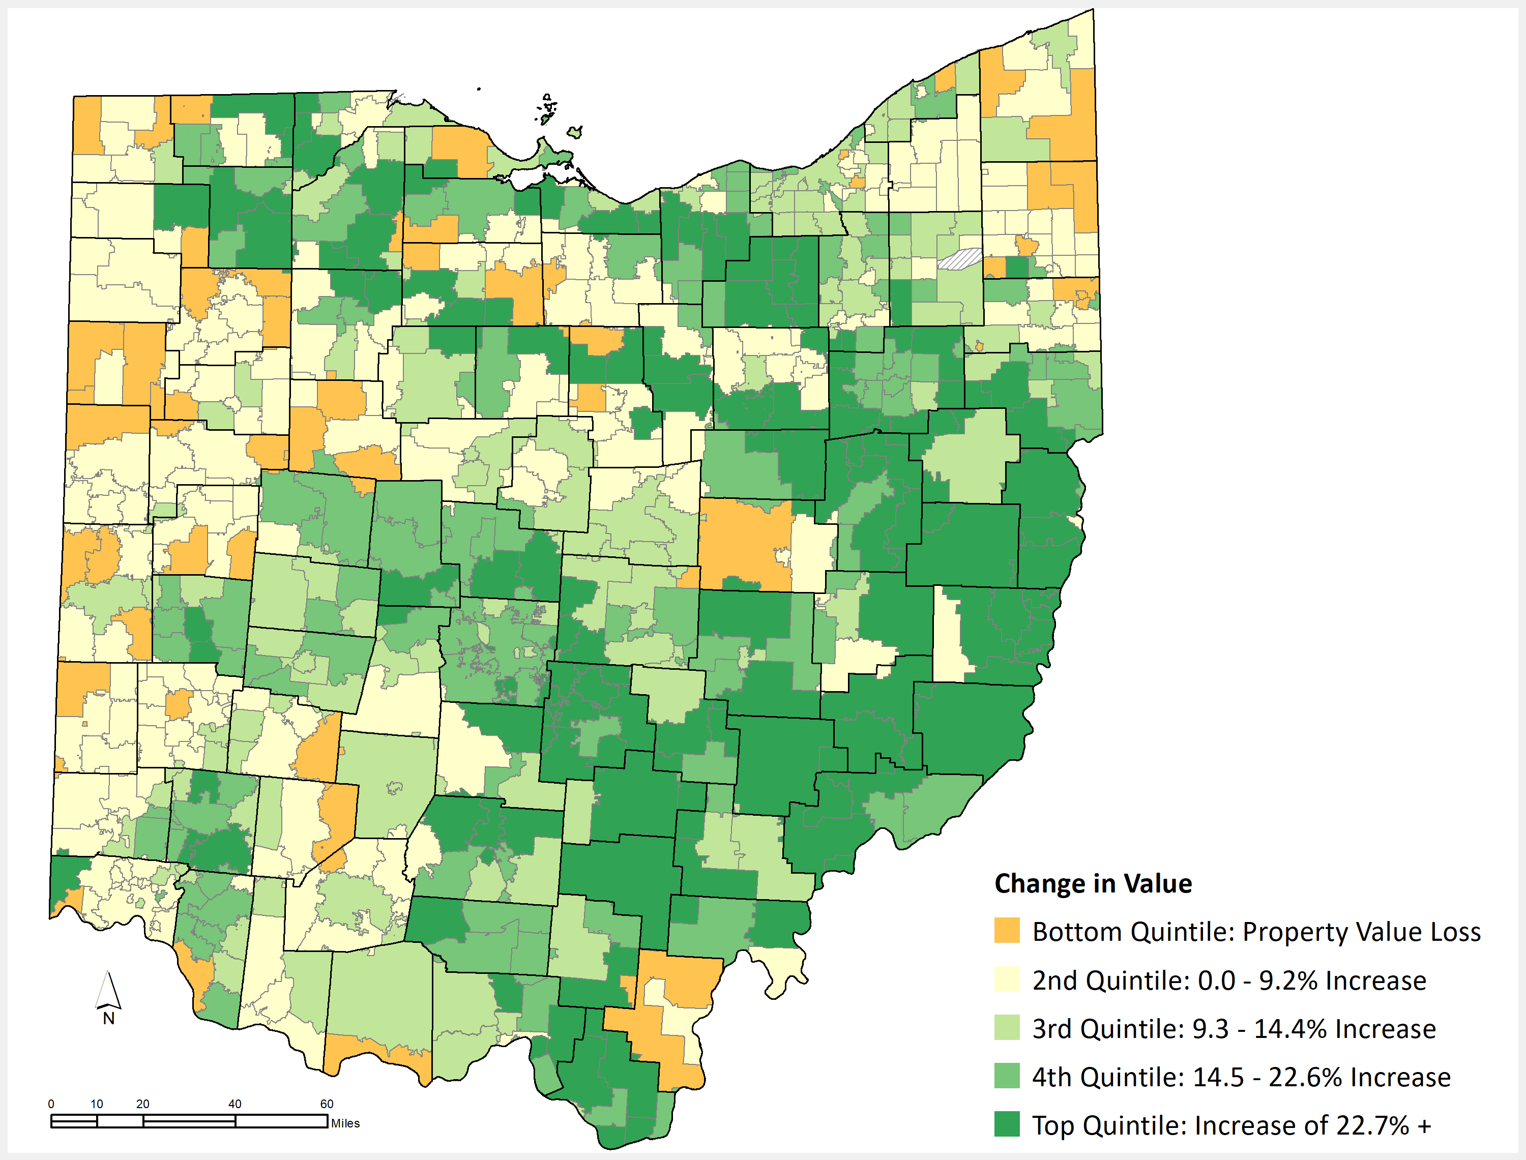
Change in Property Valuation, TY15-TY19
*Bottom quintile capped at -0.1%
Notes:
Quintiles rounded to nearest $500

Slide 26
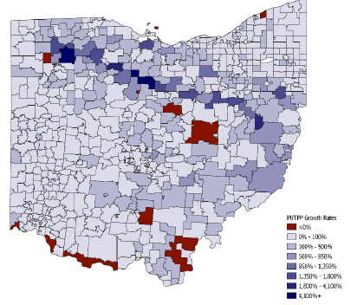
Change in Public Utility Personal Property Valuation, TY14-TY19
Notes:
Quintiles rounded to nearest $500.
Public Utility Tangible Personal Property Values Grew Rapidly in Northern and Southeastern Regions
Public utility tangible personal property (PUTPP) value, which includes property used for production, transmission, and distribution purposes, has grown rapidly since 2014. This value grew fastest in various school districts in northern and southeastern Ohio led by the recent completion of the Rover Pipeline, which carries natural gas from shale production areas to markets in the U.S. and Canada.
The school districts with largest growth (shaded in darker blues in the chart above) are generally located along the pipeline’s path and ranged from Buckeye Central Local in Crawford County, at about 56 times 2014 values (a growth rate of nearly 5,500%), to Hillsdale Local in Ashland County, at about 15 times (nearly 1,400%).
Thirteen districts, many of which have coal-fired or nuclear power plants in their territory that due to market forces have had difficulty competing with plants fueled by natural gas, have lost PUTPP value since 2014 (shaded in red). Such districts include Manchester Local in Adams County (-90.5%), New Richmond Exempted Village in Clermont County (-68.2%), Perry Local in Lake County (-54.3%), and River View Local in Coshocton County (-49.4%).
Statewide, PUTPP value nearly doubled between 2014 and 2019, increasing from $12.7 billion to $25.2 billion. PUTPP value represented 8.8% of total taxable value in 2019, increasing from 5.2% in 2014.

Slide 27
State Budget Bill Policy Provisions

Slide 28
EdChoice
Establishes direct funding for all scholarship programs (including traditional EdChoice).
Expands eligibility to include students in foster care, kinship care or who are placed with a legal custodian or guardian, plus children living in the same home as any of these students.
Increases scholarship amounts across scholarship programs.
Notes:
Senate proposed increases to scholarship programs:
Jon Peterson: from $6,020 to $6,065 in FY22 and 6,110 in FY23
Autism: from $27,000 to $31,500 in FY 22 and $32,455 in FY23
Both EdChoice and Cleveland (k-8): from $4,650 to $5,500
Both EdChoice and Cleveland (9-12): from $6,000 to $7,500

Slide 29
Community Schools
Removes restriction that community schools may only be established in a “challenged school district.”
Some COVID-related flexibilities: waiving automatic withdrawal for students who failed to test during the 2020-2021 school year and waiving automatic closure based on recent report cards.
Allows “exemplary” rated sponsors to open 2 dropout prevention and recovery e-schools per year (but not more than 6 in a 5-year period).
Notes:
Challenged school districts include 8 urban districts plus those that others identified based on performance reflected on state report cards.
Tracking for community school closure will restart when the report card issued for the 2022-2023 school year.
Sponsors that were rated “exemplary” on the most recent evaluation may open 2 DOPR e-schools per year, not to exceed 6 new schools in a 5-year period. Based on the most recent evaluations, this provision will apply to 6 sponsors.

Slide 30
Computer Science
Creation of a committee to develop a state plan for computer science education.
Committee shall include stakeholders representing career-technical education, teachers, institutions of higher education, businesses and state and national computer science organizations.
Plan shall consider best practices and challenges for computer science education, workforce needs, data collection needs.
Notes:
Other provisions related to “right to computer science” were removed, in deference to the committee completing the state plan.
Committee isn’t limited to enumerated topics for the state plan – may also address other issues as determined by the committee.
Committee must be convened not later than 30 days after the effective date of this section (September 30). Plan must be completed not later than September 30, 2022 and must be posted to the ODE website.

Slide 31
Academic Distress Commissions
Pathway out of ADC status for all 3 ADC districts.
Creation of a plan (approved by State Superintendent).
3 years to implement, State Superintendent may grant two 1-year extensions.
Based on meeting improvement benchmarks.
If not met by the end of the improvement period, revert to ADC status.
Notes:
This language went into immediate effect upon signing.

Slide 32
District Online Learning Schools
Sets parameters for districts that want to continue remote learning after the pandemic.
If engaging in online learning, a district must provide students with a computer, internet access, orientation for families.
Must have 910 hours/year and track engagement through a learning management system.
Notify ODE by August 1 for the 2021-22 school year.
State Board is charged with updating operating standards to account for online learning.
Notes:
We have sent out initial communication to districts alerting them of this new opportunity. Our Unit of Field Relations is leading implementation of this provision. Expect that the Board will hear more about the need to update operating standards in the coming months.

Slide 33
Educational Savings Accounts
Establishes the Afterschool Child Enrichment (ACE) Educational Savings Accounts Program.
Using federal COVID funds - $500 for students for supplemental academic and extracurricular activities.
ODE will contract with a vendor to implement.
Notes:
For families at or below 300% of Federal Poverty
Will be allocated on a first-come, first-served basis
$50,000,000 appropriated for FY22 and $75,000,000 in FY23
Allowable uses:
(1) before- or afterschool
educational programs, (2) day camps,
including camps for academics, athletics,
and arts, (3) tuition at learning extension
centers or learning pods, (4) if a student is
receiving home instruction, purchase of
curriculum and materials, (5) educational,
learning, or study skills services, (6) field
trips to historical landmarks, museums,
science centers, and theaters, including
admission, exhibit, and program fees, (7)
language classes, (8) instrument lessons, or
(9) tutoring.

Slide 34
Licensure
Permits State Board to take action against the license of a school employee that assists a student in cheating on an assessment.
Adds human trafficking to the list of offenses for which a license must be revoked or denied.
Prohibits a school representative from assisting an individual in obtaining school employment if the representative has cause to believe the person has committed a sex offense involving a student.
Notes:
- SBOE action against a license could be suspension, revocation or limitation; current law allows a 1-year suspension for specifically revealing test content

Slide 35
Let’s Stay Connected
Aaron.Rausch@education.ohio.gov
614-995-9936

Slide 36
@OHEducation

